Slide 1
Acquisition Gateway Chatbot
AG2

Slide 2
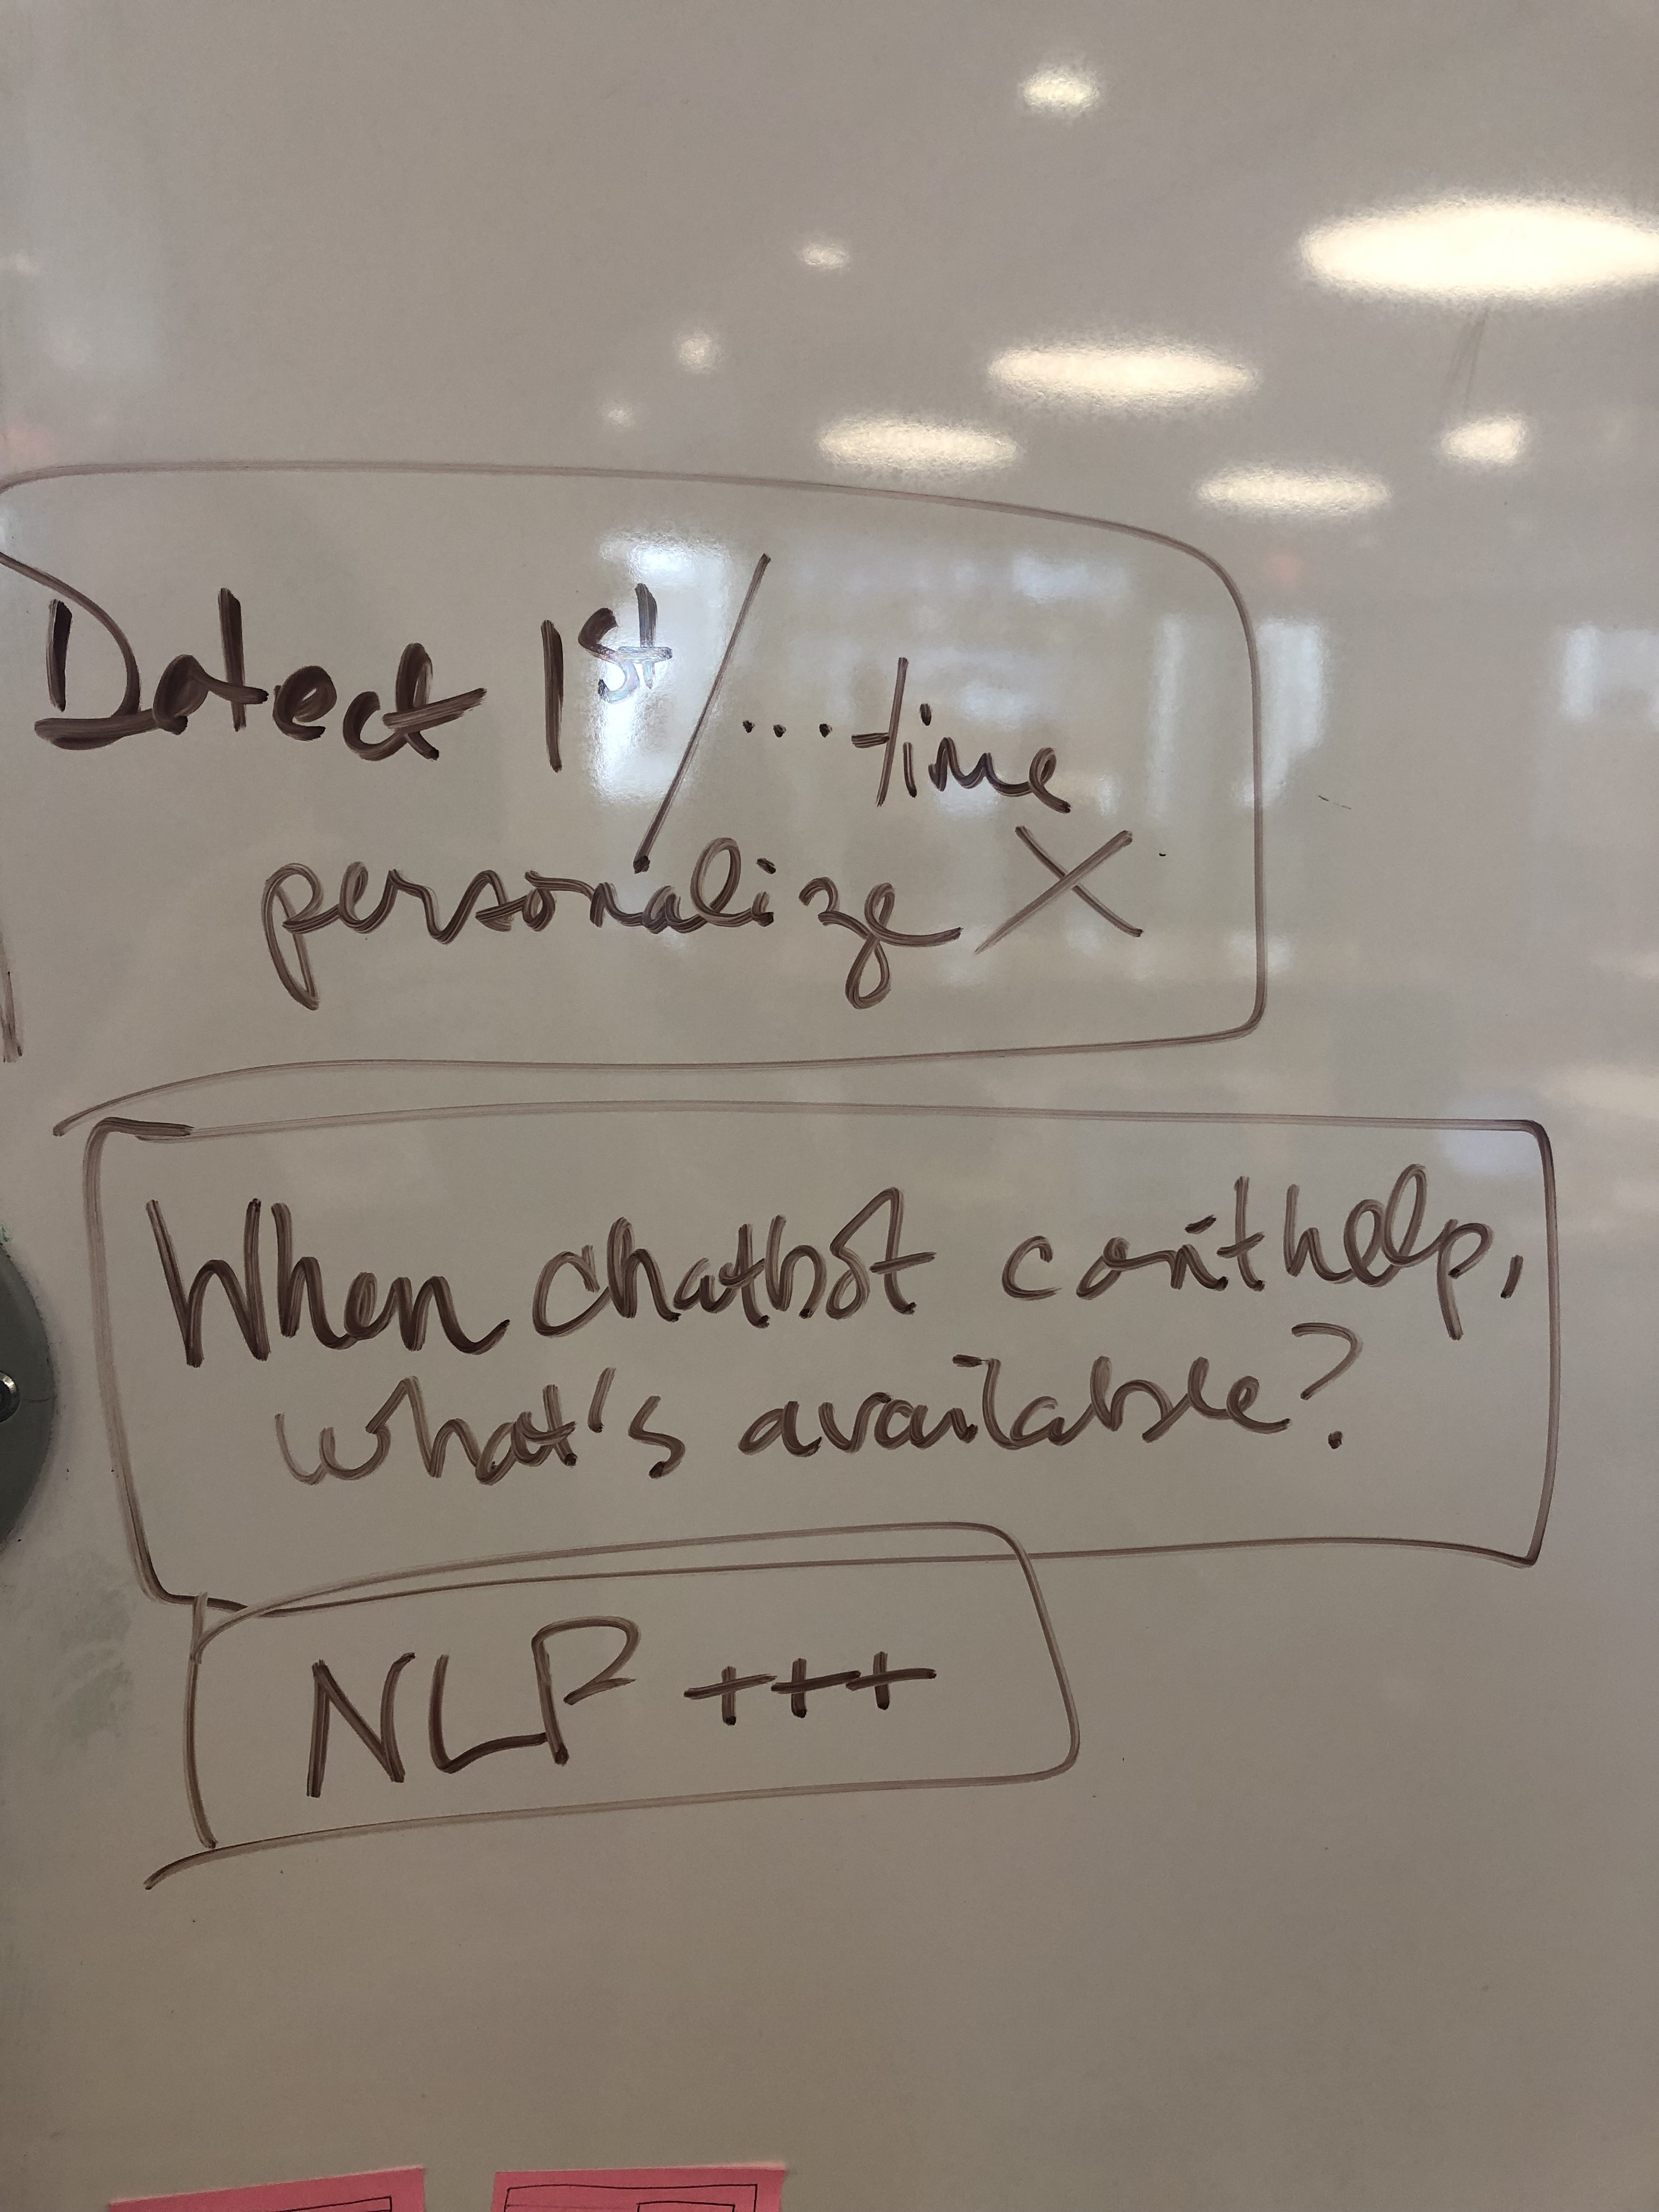
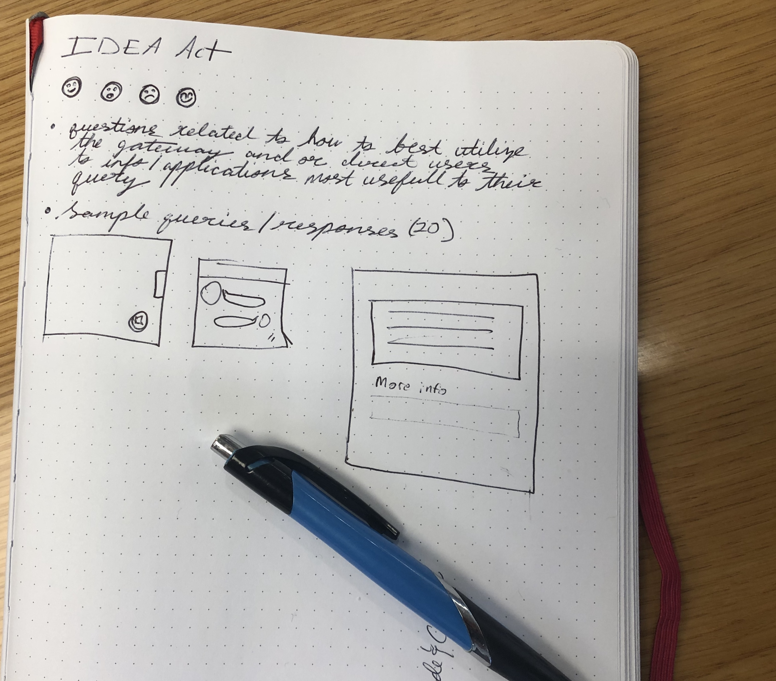
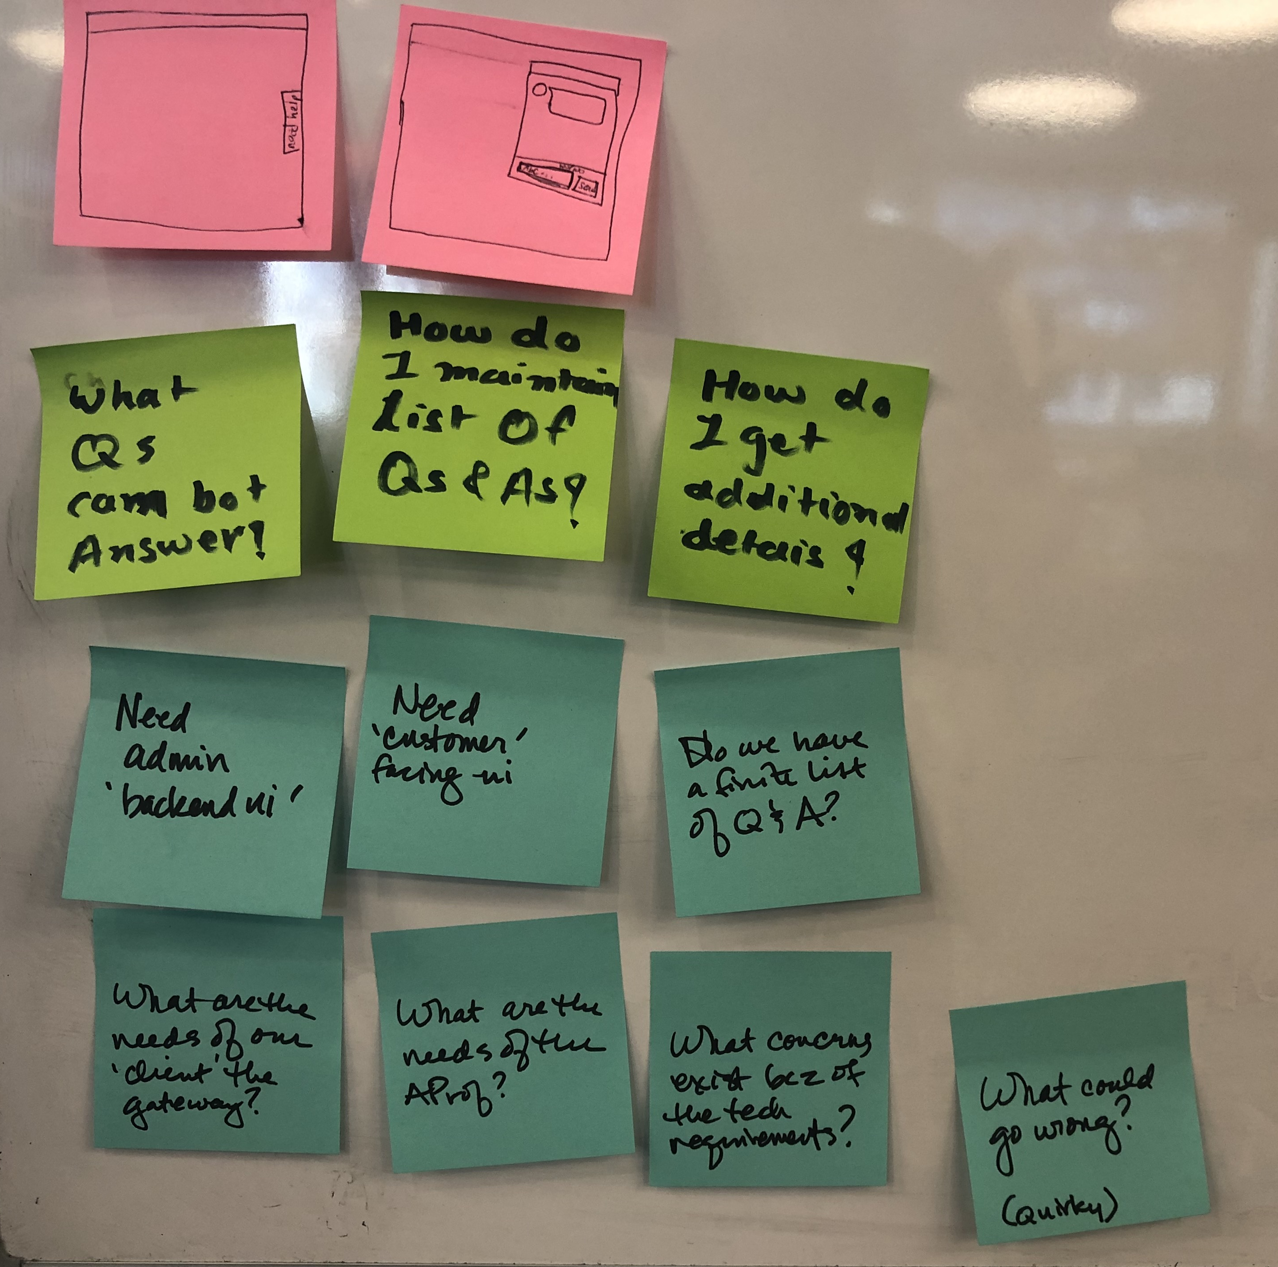

Slide 3
Brainstorm, Next Steps
Design: Acquisition Professional UI
Design: Acquisitions Gateway Admin UI
Develop: Functional Chatbot
Next Steps
Document assumptions and unknowns
Questions and answers
Research acquisition professional
Gather resources, best practices
Review other federal chatbot
Test chatbot solutions
Notes:
https://www.ibm.com/cloud/blog/chatbot-best-practices
https://www.va.gov/find-locations/

Slide 4
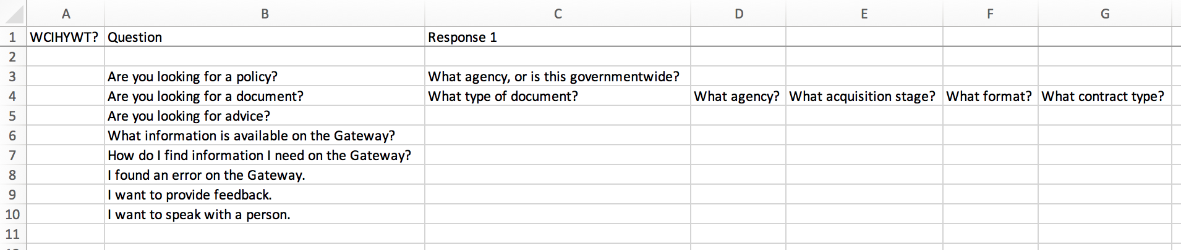
What can I help you with today?
Are you looking for a policy?
What agency, or is this governmentwide?
Are you looking for a document?
What type of document?
Are you looking for advice?
What agency?
What information is available on the Gateway?
How do I find information I need on the Gateway?
I found an error on the Gateway.
I want to provide feedback.
I want to speak with a person.
What acquisition stage?
What format document do you need?
What type of contract?

Slide 5
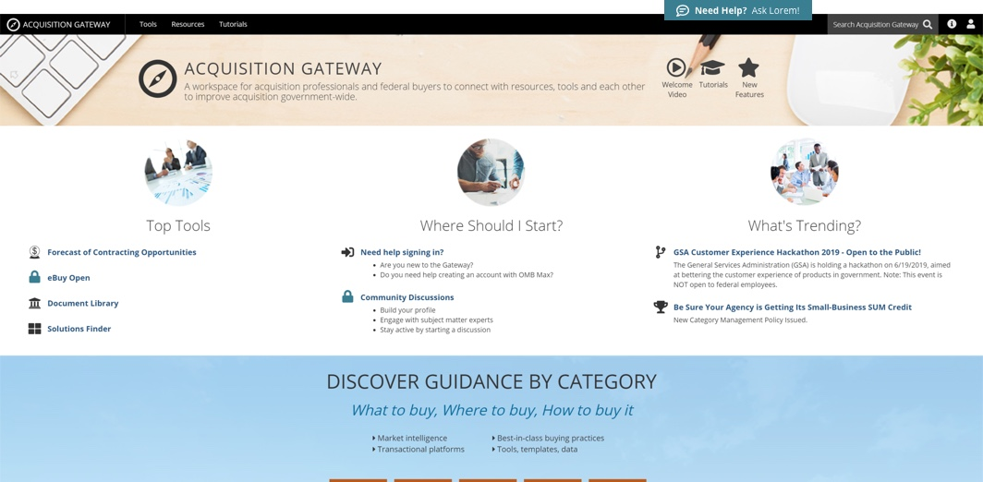
Acquisition Professional UI

Slide 6
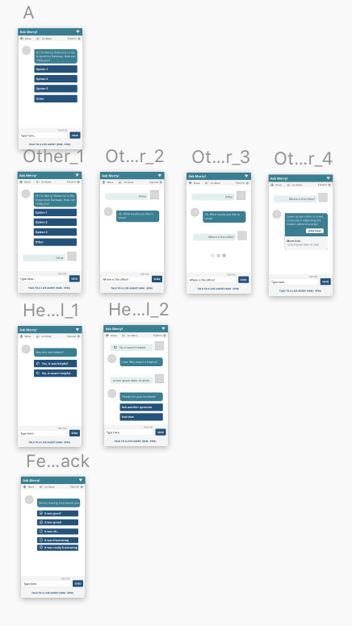
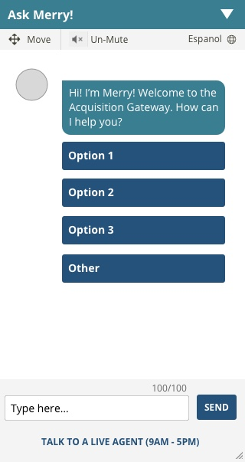
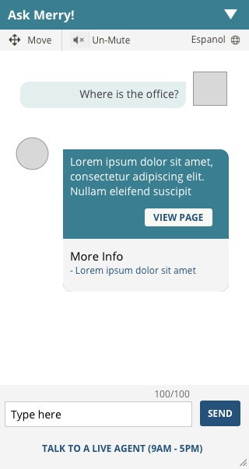
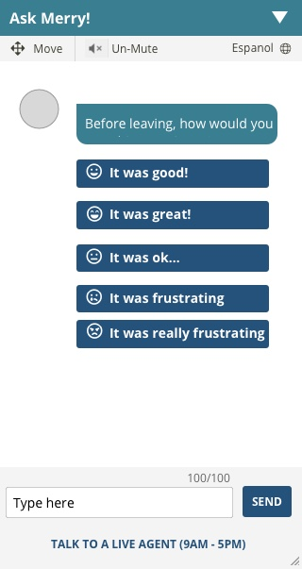
Acquisition Professional UI

Slide 7
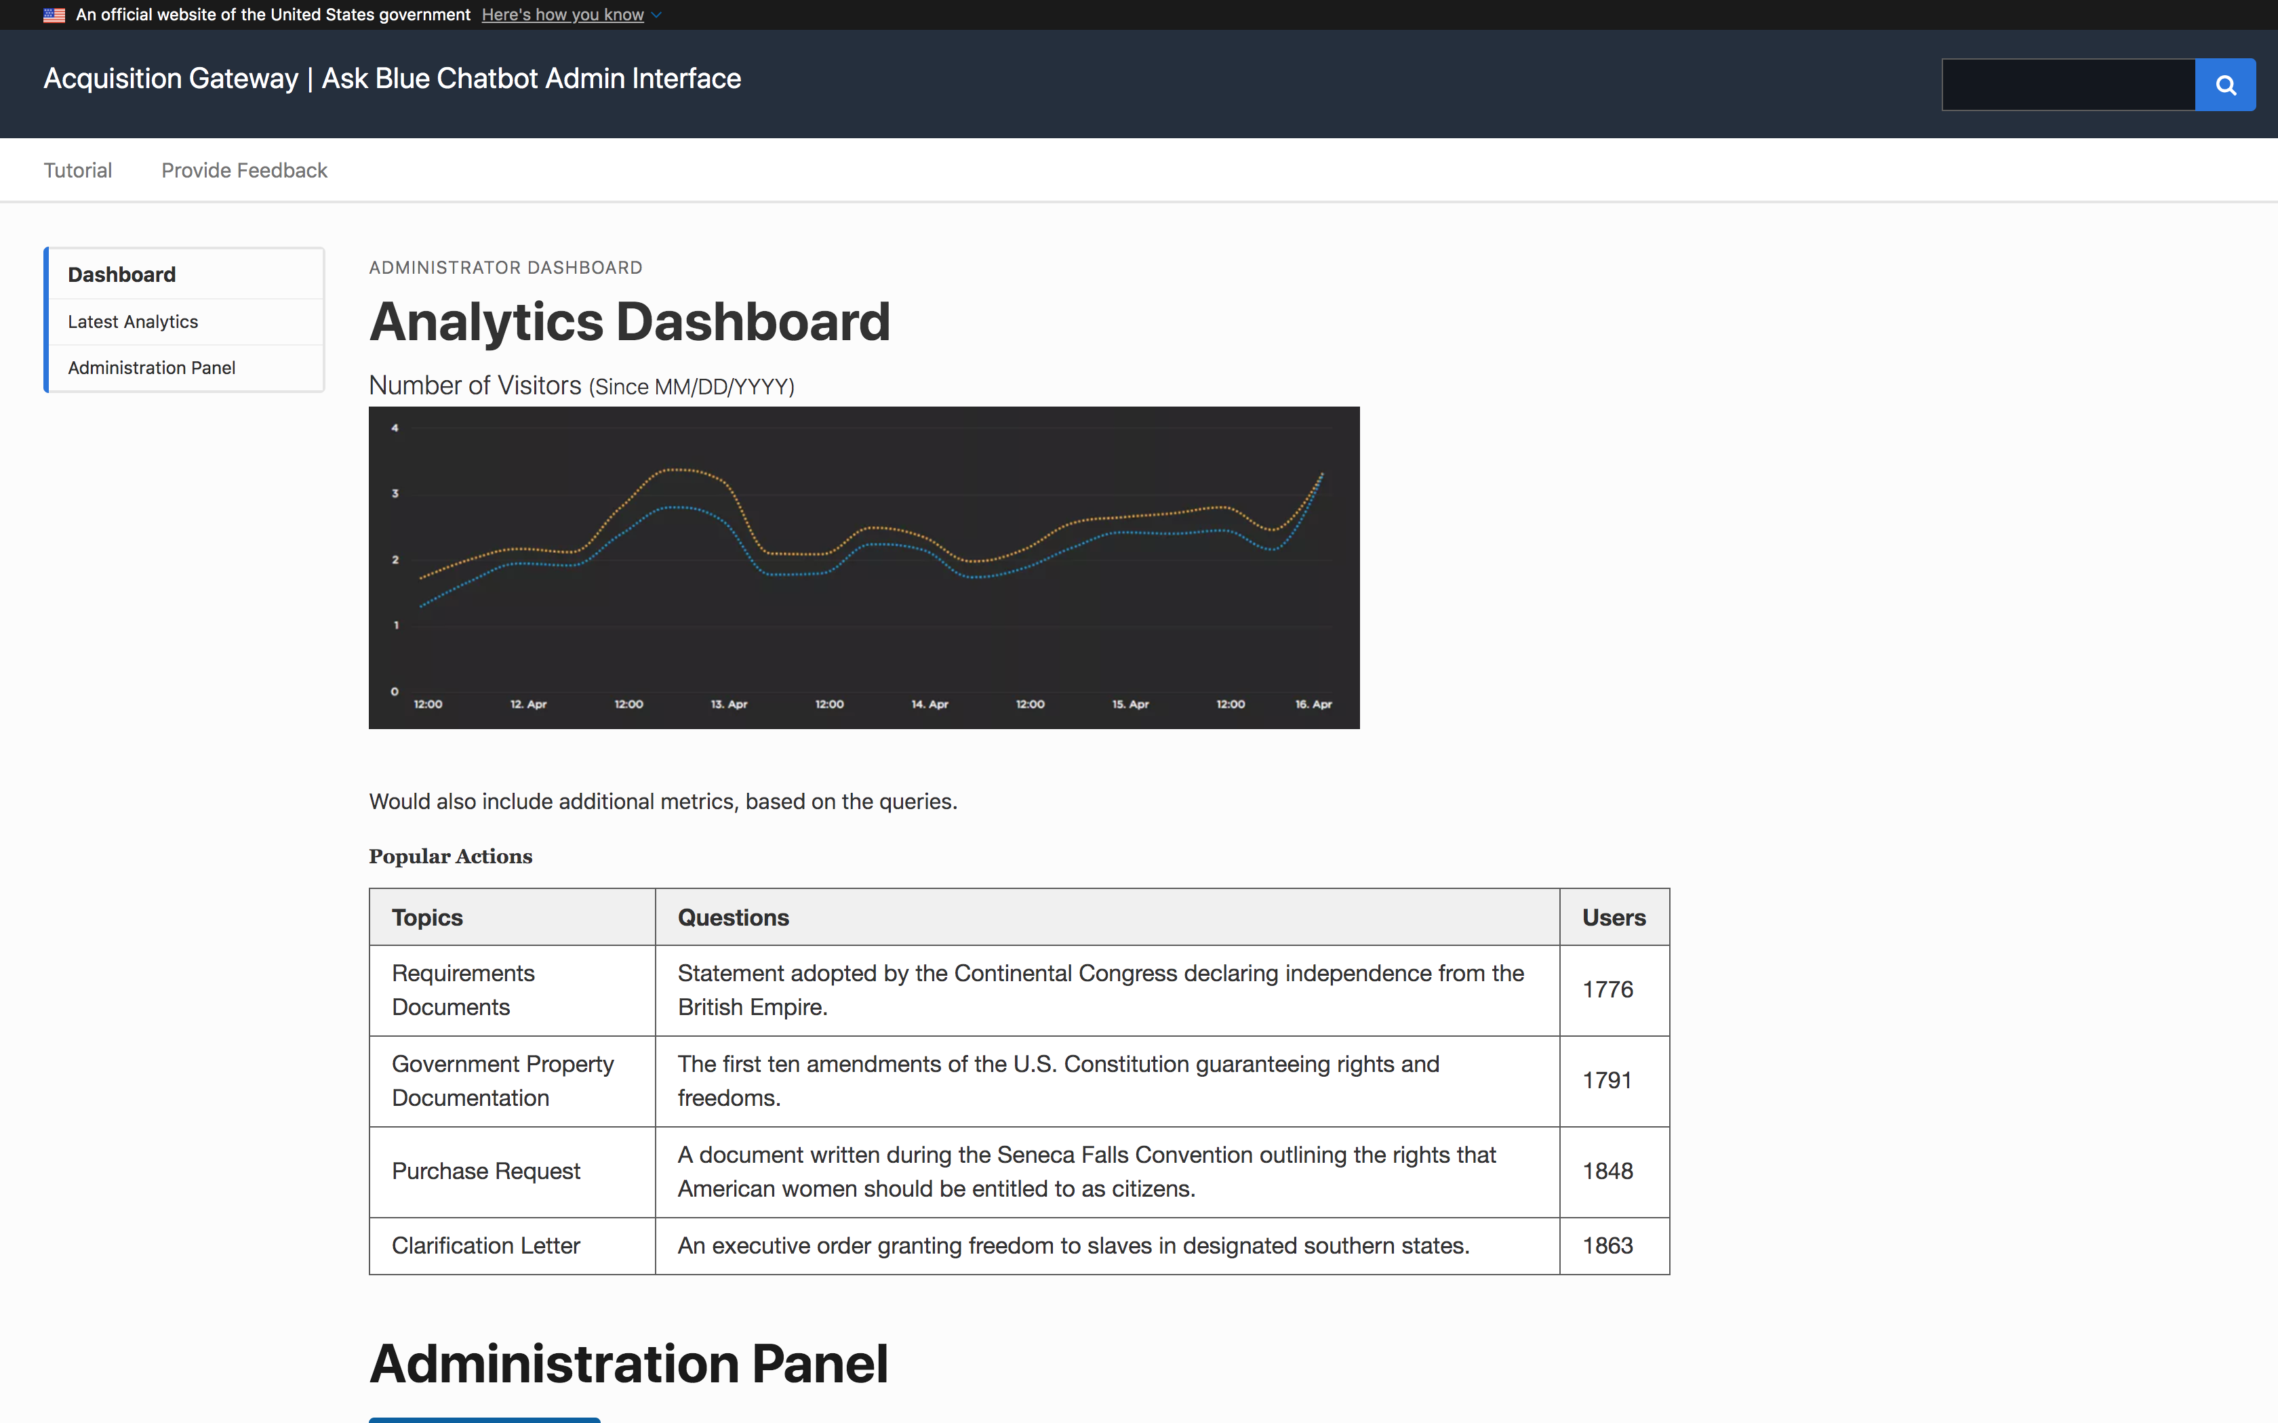
Admin UI

Slide 8
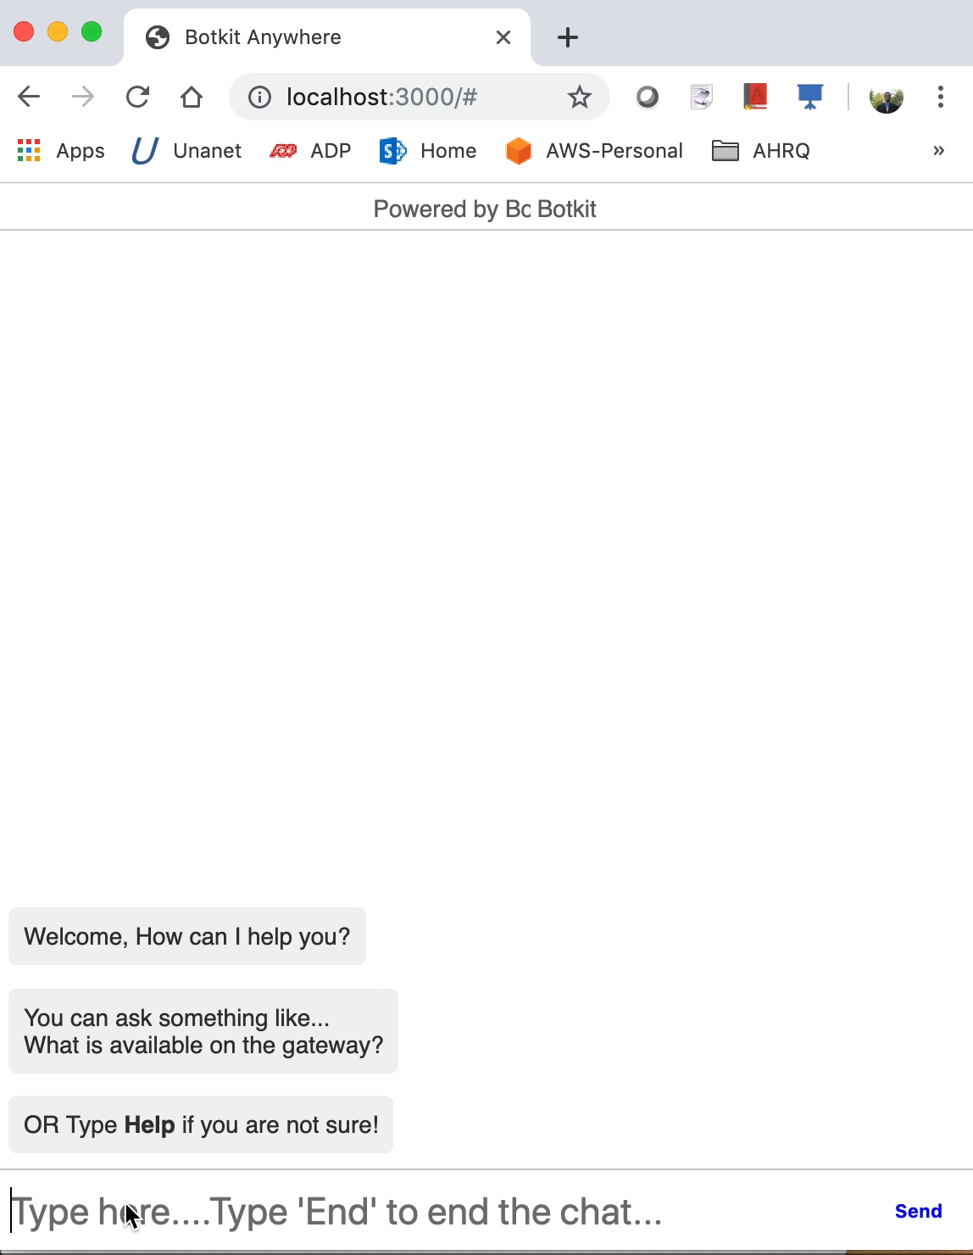
Chatbot Functionality

Slide 9
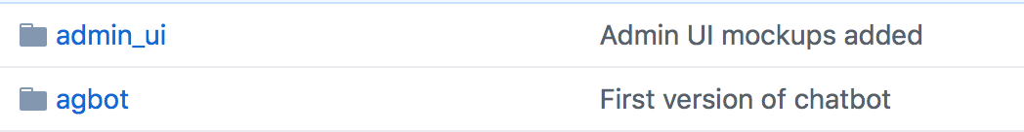
Github repo
https://github.com/sonimehul/hackathon-acquisition-gateway

